Slide 1
An Introduction to Lead Generation

Slide 2
Table of Contents
03
Introduction
04
What actually is a lead?
06
Lead generation: first steps
15
The mechanics of lead generation
17
Tools to assist you in lead generation
18
How to manage your leads
21
A real example of a lead gen campaign
22
Plan remarkable experiences
2

Slide 3
Introduction
For most companies, it’s a challenge to find ways to acquire customers and minimize the cost of their acquisition. With a broad range of competitors striking from everywhere and pledging their offer as the most efficient alternative, it may cause some stress around what actually works.
In the majority of cases, a digital lead generation strategy is the answer. Through a lead gen strategy, companies can seek and attract people interested in their products and services, who may become prospects after a proper nurturing process.
HubSpot and Rock Content, two global leaders in digital marketing, have joined forces to guide you closely through the processes of better understanding lead gen. In this ebook, you’ll learn what it takes to tailor-make a strategy for your business.
3

Slide 4

What actually is a lead?
Let’s start with the basics: clarifying concepts.
A lead is a person who has in some way, shape, or form indicated their interest in your company’s product or service. Normally, this is done by a
contact providing you with their information — like their name, email, or phone number — in exchange for information about your product or educational material for your industry.
Therefore, lead generation is the process of attracting and converting as many strangers and prospects as possible. Then, your buyer’s funnel will guide these contacts all the way to the purchase moment.
Some examples of lead generators are job applications, coupons and online content such as courses, ebooks, product demonstrations, and more.
Why do you need lead generation?
Having a lead gen strategy can help you achieve predictability for your company. Let’s be honest: leads don’t come out of nowhere. They are all over the digital space, but you must have a connection if you want to capture them.
In time, you will understand more about the performance of these channels and how you can forecast the volume of business that your company can achieve because of the leads conquered.
Additionally, few people might be ready to buy your products or services right now. But when you capture and nurture leads, you have a possibility to build a relationship with those people, expecting that — when they are ready to buy — your company will be the first solution on their minds.
4

Slide 5

Different types of leads
The term “lead” can be used by any company that wants to generate new business opportunities. However, different business models require different lead generation strategies. Therefore, we separate them into two groups: leads B2B and B2C.
B2B stands for business to business, a company that sells to other companies. B2C stands for business to consumer, a company that sells directly to individuals.
When a company prepares to acquire a new product or hire a service, the decision process is usually left to senior managers.
Therefore, the purchase goes through numerous approvals and evaluations from different people before being carried out. If you sell to other organizations, your audience is not just the end customer, but also everyone involved in the decision process.
That’s why the B2B sales cycle is usually longer.
In contrast, B2C buying is often an individual process and can be made more impulsively and without the red tape
If you’re interested in buying sneakers, for example, you are probably the one making the decision about it, right? You don’t need to consult other people. Therefore, the B2C lead generation strategy already focuses more on the final purchase decision than on convincing several people about the value of a solution.
5

Slide 6

Lead generation: first steps
Now, let’s break down what a Lead Generation strategy is, what you need to build one, and what are the best practices to put it into action. But here’s a reminder: there is no such thing as a “ one-size-fits-all” strategy. Select what fits you better and apply to your context.
Define what a lead is to your business
Now that you know the general definition of a lead, you need to discover what a lead is to your business. In other words, what’s
fundamentally necessary for your sales team, so they can evaluate if someone is a good fit or not to do business with your company?
For example, at Rock Content, the lead definition is “someone who has shown interest in any of our rich materials and filled out a form with six fields: name, email, phone number, website URL, number of employees, and company industry.”
Let’s dive deeper into the reasons why we chose those six pieces of information
Name: The basic information needed for communication with the to-be lead.
Email: It will allow the marketing and the sales team to communicate with the person. Phone number: It will be used by your sales team to actually reach out to the lead and open conversations.
Website URL: This will give the sales team the ability to research what the business does and how the lead might benefit from your product or service (mainly for B2B).
Number of employees: After years of experience and data analysis, Rock Content came to the conclusion that our products are not a good fit for small companies. Therefore, this
information serves two purposes: to identify people that work in companies with less than five employees and to understand which sales team this contact should be sent to, since our team is specialized in small or big companies.
Company industry: Another piece of information necessary for internal purposes, since Rock Content has a specific program for capturing marketing agencies as partners.
6

Slide 7
When deciding what a lead is to your company, you must evaluate:
The amount of information needed.
The information sensitivity level.
The difficulty level to acquire the information.
If your sales team needs a big amount of information, you might need to structure your lead capture in stages, starting by collecting the simpler data and then going to the more complex, sensitive information.
In a case where you need more complex data, such as the issue they’re currently facing, someone’s gross revenue, or anything too specific, you might have trouble converting people into leads.
While the above examples are exaggerated, the lesson is serious: Keep things simple and order only what is really needed.
It is also important to remember that the world is undergoing a revolution in terms of data privacy. Pay attention to the legislation in force in your country. For more information, search the legislations for Canada (CASL), Europe (GDPR), Brazil (LGPD), and others.
Get to know your buyer persona
One task that can help you define the information needed for someone to be considered a lead by your company, and for all the other digital marketing strategies that your company has, is defining your buyer persona.
Buyer personas are semi-fictional representations of your ideal customers based on data and research.
Buyer personas provide tremendous structure and insight for your company. It makes it easier for you to tailor your content, messaging, product development, and services to meet the specific needs, behaviors, and concerns of the members of your target audience.
When creating yours, consider including customer demographics, behavior patterns, motivations, and goals. The more detailed you are, the better.
7

Slide 8
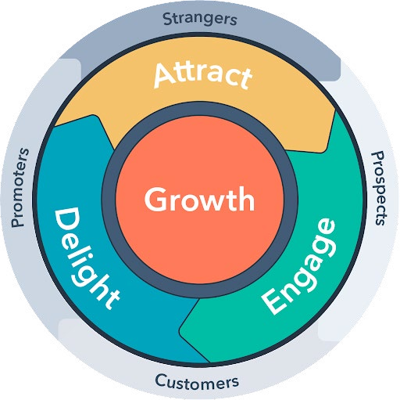
Create a compelling offer
To attract people that might be interested in doing business with you, you must show or offer something interesting to them. But even if the offer is very good, they might be suspicious because they don’t know you that well.
The secret to success here is to structure a strategy that will help you build positive relationships, and then think about doing business.
To achieve this, you should utilize an inbound marketing approach.
What is inbound marketing?
Inbound marketing is a methodology where you grow your business by building meaningful, lasting relationships with consumers, prospects, and customers.
HubSpot is the worldwide precursor of the notion that people don’t want to be interrupted by marketers or harassed by salespeople — they want to be helped.
Inbound marketing is about empowering people to reach their goals at any stage in their journey with you.
After all, when your customers succeed, you succeed.
The inbound methodology can be applied in three ways:
Attract: Drawing in the right people with valuable content and conversations that establish you as a trusted advisor with whom they want to engage.
Engage: Presenting insights and solutions that align with their pain points and goals so they are more likely to buy from you.
Delight: Providing help and support to empower your customers to find success with their purchases.
8

Slide 9
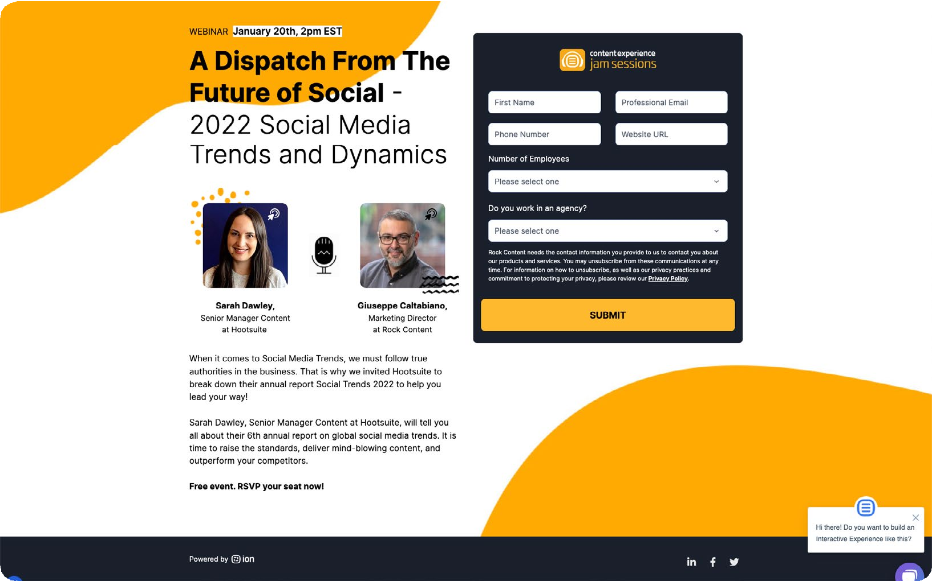
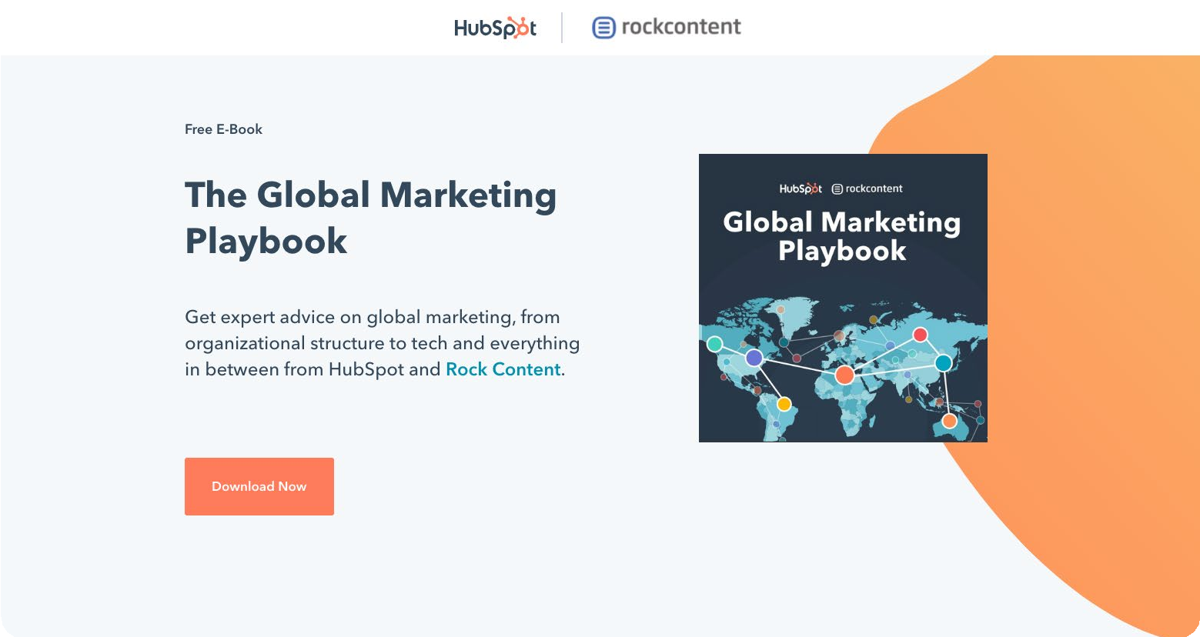
When customers find success and share that success with others, it attracts new prospects to your organization, creating a self-sustaining loop. This is how your organization builds momentum, and this is why the inbound methodology serves as a strong foundation for your flywheel.
With inbound marketing, potential customers find you through channels like blogs, search engines, and social media. It’s the opposite of outbound marketing — the traditional advertising method where the brand interrupts people when they aren’t actively seeking that information (like when they’re watching TV.)
Inbound marketing does not need to fight for potential customers’ attention. By creating content designed to address the problems and needs of your ideal customers, you attract qualified prospects and build trust and credibility for your business.
Examples of content offers and “lead magnets”
The possibilities for offer creation are endless. It all depends on your company and the tastes of your audience. Here are some of the most common ones:
Webinars: Webinars are events, video presentations, workshops, seminars, training sessions, or classroom lectures hosted and delivered online. They became even more popular after the pandemic.
Ebooks: The digital cousin of traditional books. This type of content is usually long and deep, exploring concepts, stories, and examples about a subject. They were very popular in
the 2010s, and until today ebooks represent a strong asset for lead capturing. Although, there’s got to be cautious when using them, since their popularity diminished their
authority on the matter. So, try to fit this format of resource into the best step of your
buyer’s journey.
9

Slide 10
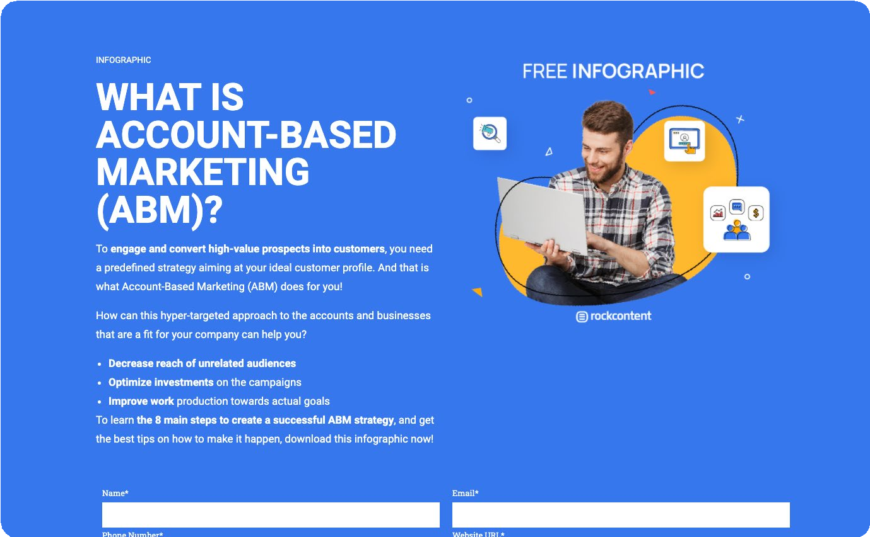
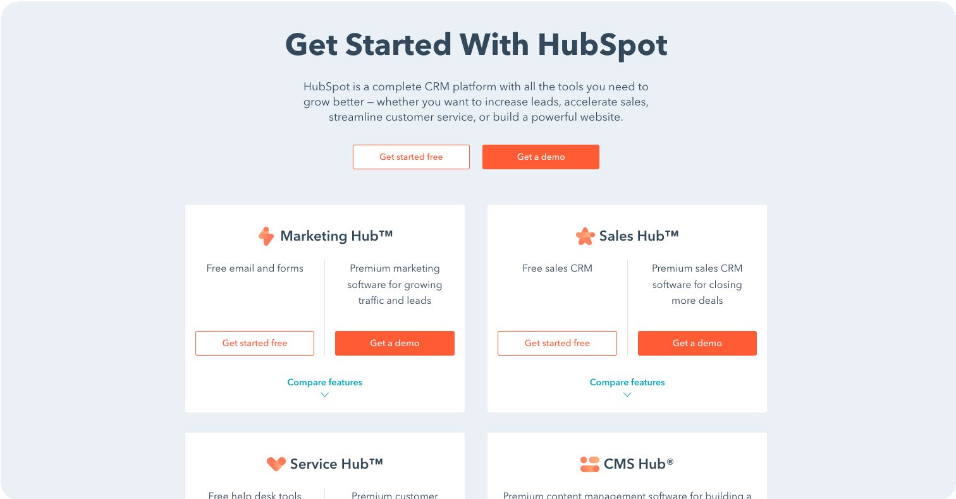
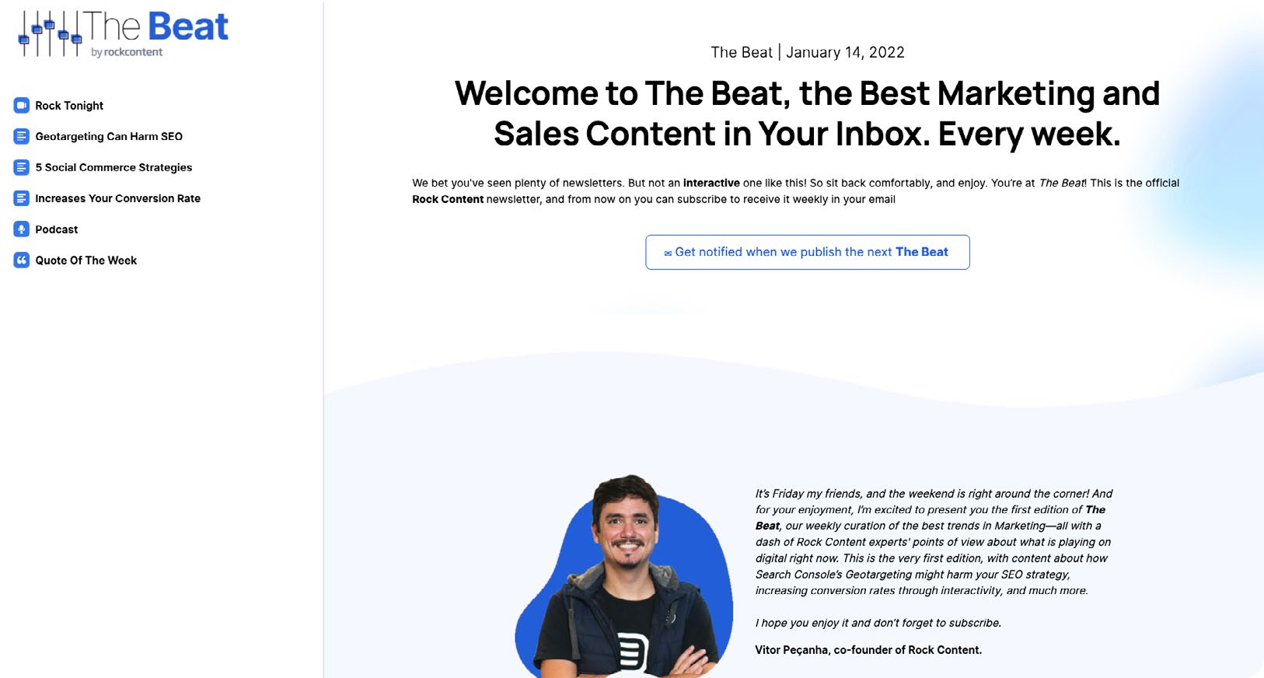
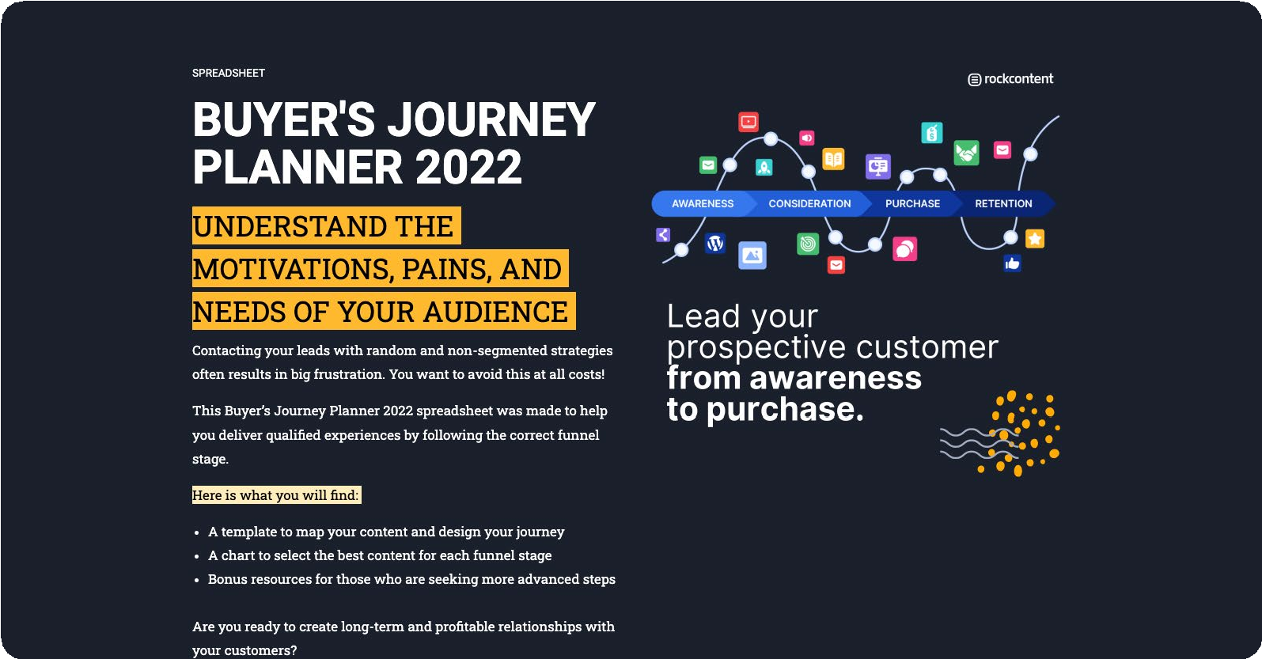
Infographics: An infographic is a visual representation of information and data. It’s excellent for educational purposes. In the virtual world, the interactive versions manage to attract more attention and even allow the capture of data regarding the consumption of infographic information.
Product demonstration: Demos are considered a decision-stage lead magnet. Anyone who shows interest in seeing a demonstration of your product is probably on the market, looking out for a solution. Demos will likely attract a small number of people, but they will also be your sales team’s favorite contact type.
Newsletter subscription: Usually, this is the first lead magnet of any blog. Newsletters can bring exclusive content, curate content, or just promote articles available on the blog. The secret to success lies in following good email marketing practices and having a strategy behind its use.
Templates: They can be in a document, spreadsheet, or slide format. If there is something complex or repetitive that you can help your audience do correctly, or in a faster way, then this offer can bring in a lot of leads.

Slide 11
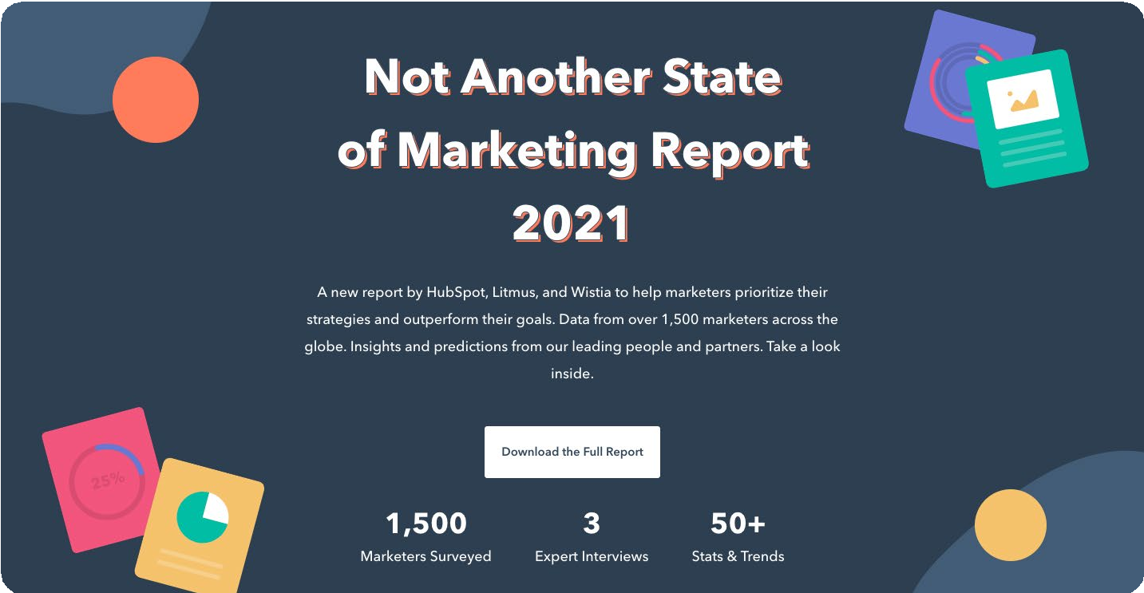
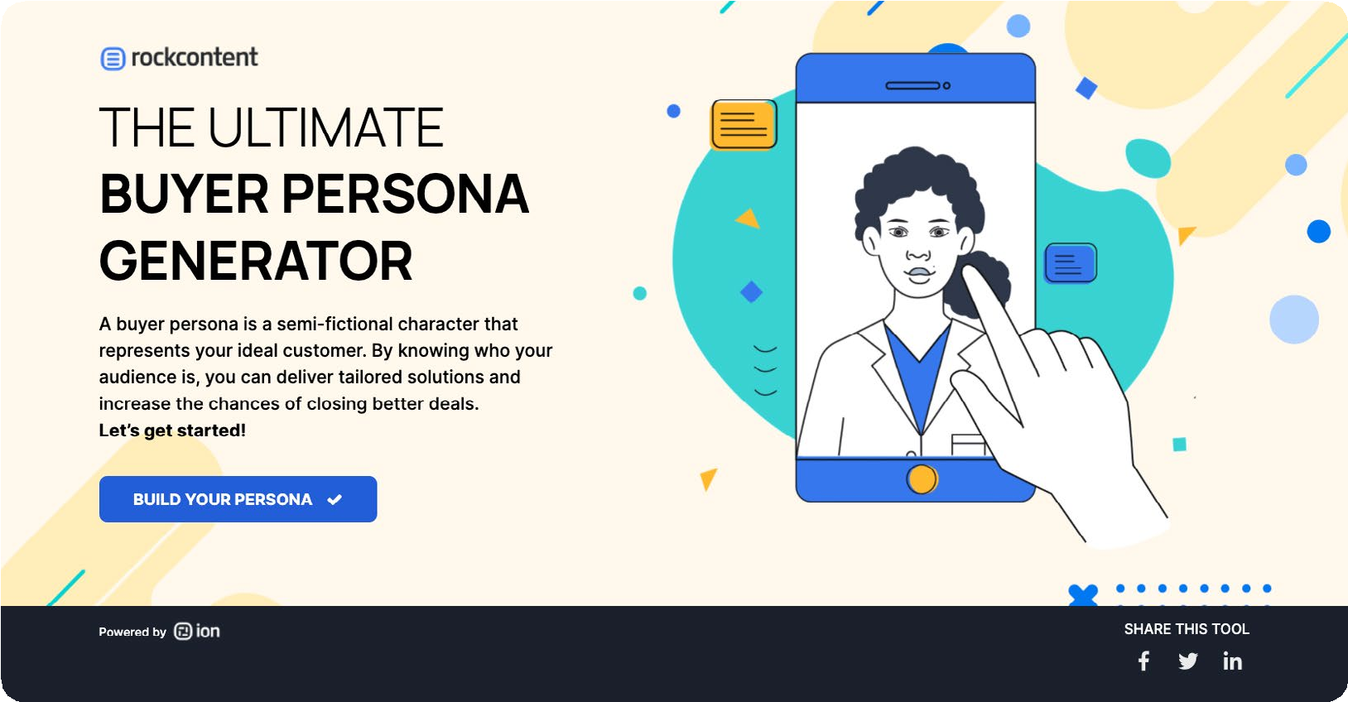
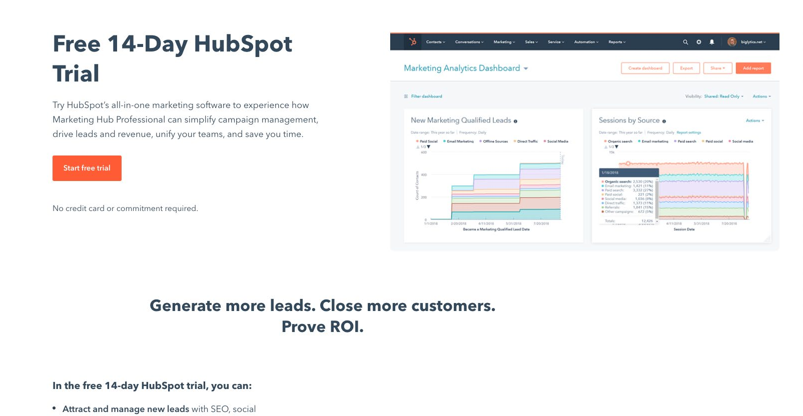
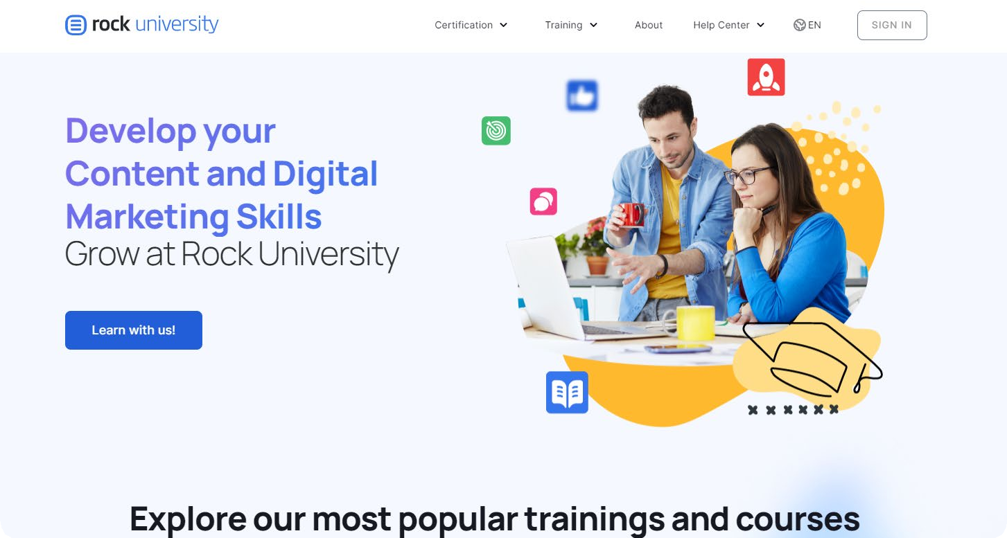
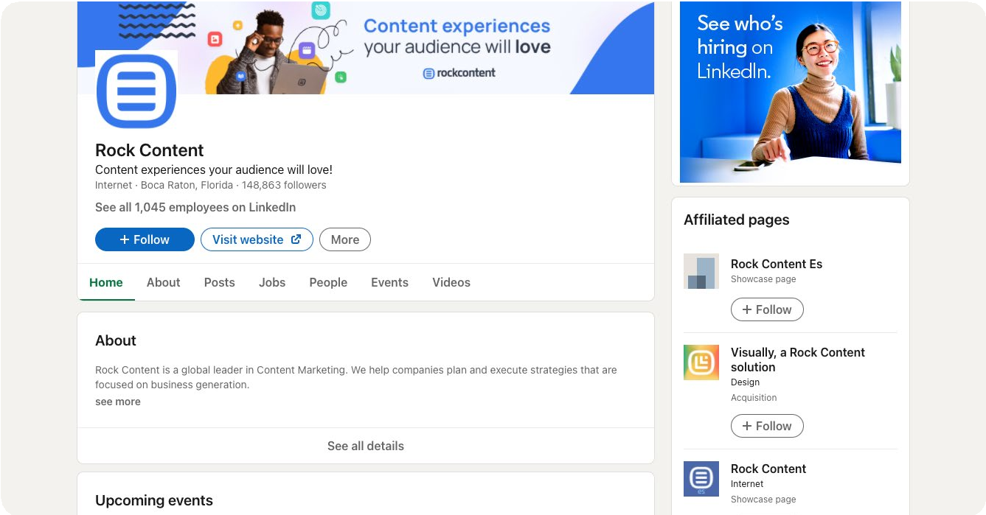
Survey reports: Surveys are long and complex projects. They involve the collection, organization, and analysis of a lot of data.
Interactive tools: Tools like calculators or quizzes are great for capturing leads.
Furthermore, in theory, through technology, any template can become a beautiful interactive tool. The positive point of the tools is that they capture and store data that can later be shared with the sales team.
Free trials: This type of offering is great for innovative, complex or expensive products.
In this way, future buyers can try the product or service without fear and only then decide if they want to buy it.
Courses: Courses can be delivered via text, video, or audio. Choose your audience’s preferred format and share your knowledge. They are powerful in terms of building relationships.
Access to closed communities: Forums, Facebook groups, LinkedIn groups, Slack channels — there are several communities that allow networking and access to privileged information. If your company has such a community, you can use it to hook
potential customers.

Slide 12
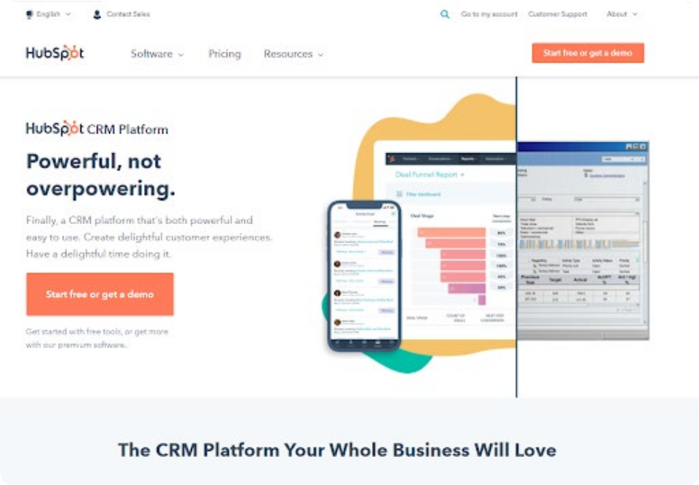
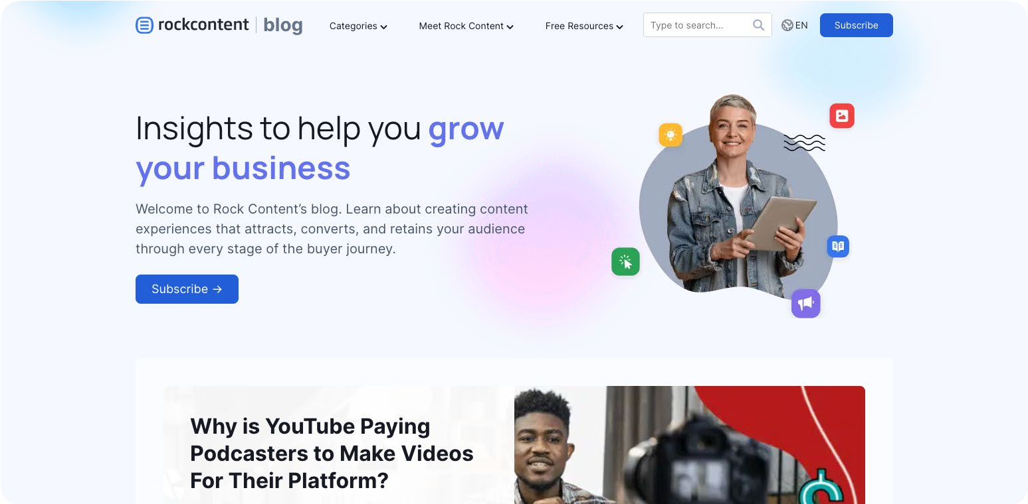
Give visibility to your offer
Once the offer is created, get to work on promoting it. Ensure visibility across all channels that resonate with your audience. And you can do it two ways:
More volume, less depth
More depth, less volume
Meaning you can choose to spread the news all over the internet promoting your lead gen offer, letting multiple channels reach out to your content; or, you can create a more tangible narrative, as a success case, for instance.
Here is how it would look like in practice:
Website Pages
Mastering digital channels is basically mandatory for all sorts of businesses now. Having a website to guide the audience through your experience can work as a very effective landing page. Throughout the pages, connect some of your lead-gen offers to boost the value of what you’ve been talking about.
Several companies have a “resources” tab inside the menu of their website. It’s a great place to list ebooks, webinars, templates, and courses.
Blog
Having a blog is a great way to enrich your online presence and capture the attention of your audience. Whenever you have a lead gen offer that connects with a blog post, remember to add links or banners to it.

Slide 13
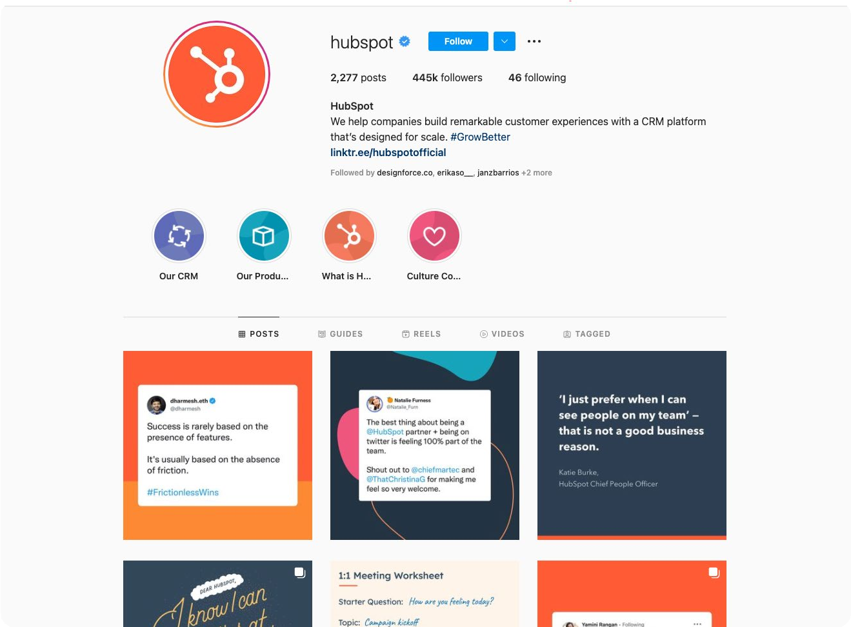
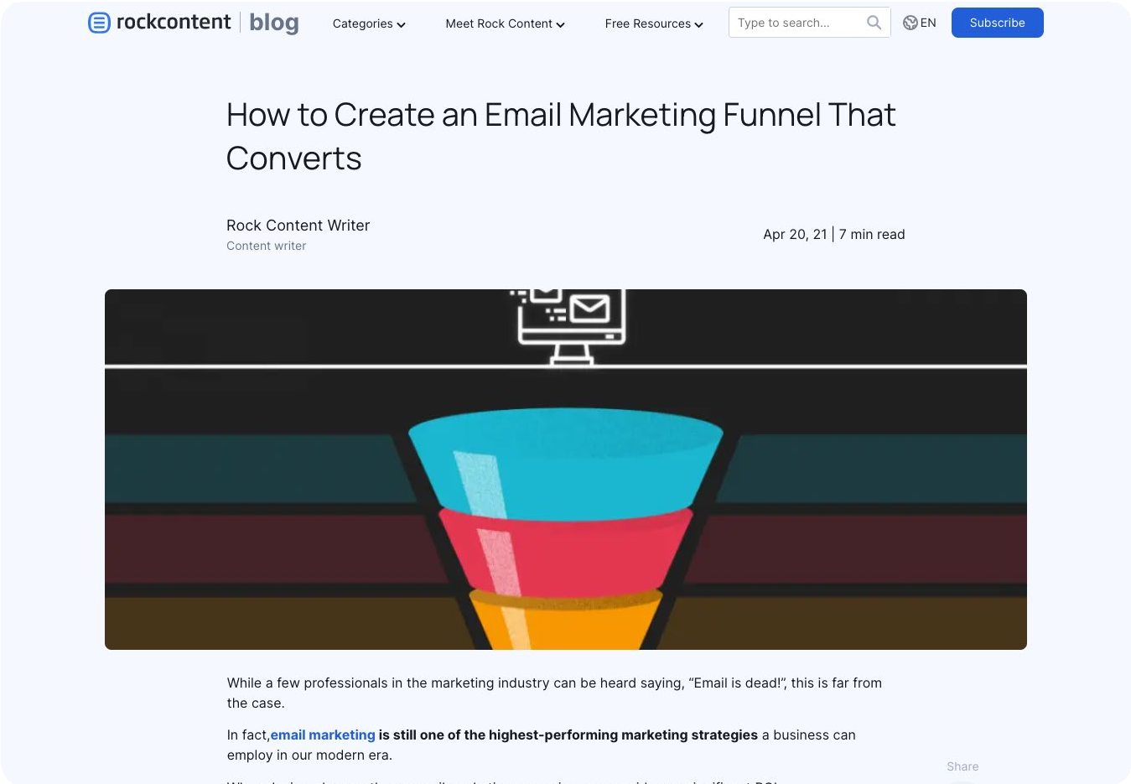
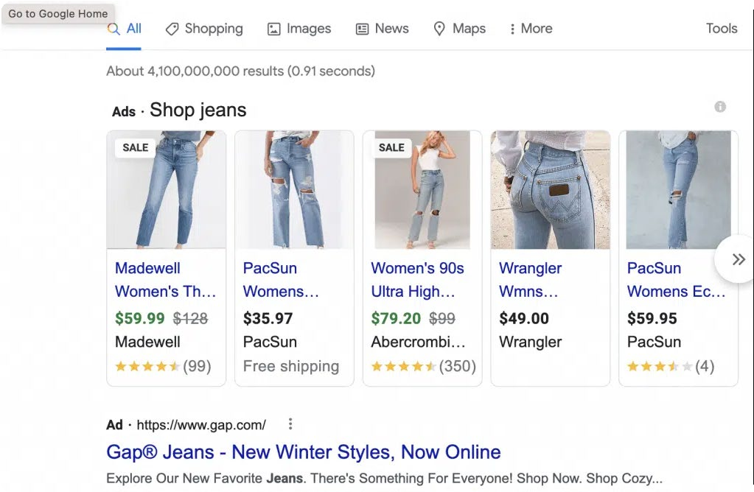
Social Media
Facebook, LinkedIn, Instagram, Twitter, TikTok
— the list is endless. Social networks attract millions of people. If you know that your audience has a preference for any of these platforms, you must create a strategy to be there as well.
Email Marketing
If you’ve ever heard the expression “email is dead,” erase that memory immediately! Or, at least, don’t believe that sentence.
With 3.9 billion users worldwide, email marketing can be a powerful channel for your business to acquire new customers and nurture relationships with existing ones.
Whenever you launch a new lead generation offer, promote it via email. This is an excellent tactic for reactivating dormant relationships.
Also, if your offer is attractive, readers may forward your message to coworkers, friends, and family, expanding your reach even further.
Paid Media
Whenever you’re having trouble getting your offers out there (or when you want to achieve even greater results), promote your lead magnet through paid media.

Slide 14
Public Relations
If the offer you created has unique characteristics, why not tell the world about its existence?
If it makes sense, launch a press release seeking media coverage.
You can also contact partner companies and propose co-marketing actions, where leads are shared between the two companies.
Case Study
In case you not only want to spread your content around but actually prove value over them, build a successful case study. By doing this, you can maximize the relevance of your resource, showing your audience how they might benefit from it, and teach how they can do it too.
A great example of building a successful case to endorse lead-gen content is the case study of how this marketer who grew lead conversions in 431% using this certain tool.
Track your results
The final step of your campaign should be collecting and analyzing your results to understand what went well and what could be improved.
Keep an eye on your metrics, such as:
The total amount of views: The number of people that arrived at the landing page of your offer.
Return on investment (ROI): It’s used for measuring the probability of gaining a return from an investment. You can calculate it by dividing the net return on investment by
the total cost of the investment and then multiplying it by 100.
Downloads/subscriptions/registrations: The number of people that submitted a form to get access to your offer.
Cost per lead: It measures how cost-effective your marketing campaigns are when it comes to generating leads for your sales team. You can calculate it by dividing the total amount of investment by the number of leads generated.
Conversion rate: It’s the number of downloads divided by the number of views of the landing page, and then multiplying by 100.

